Slide 1

Modification-free extensibility for existing apps
Sebastian Wennemers,
Joaquin Recio Huertas,
Aditya Bhatia
June 28, 2019
Notes:
We are from the SAPUI5 Flexibility area

Slide 2
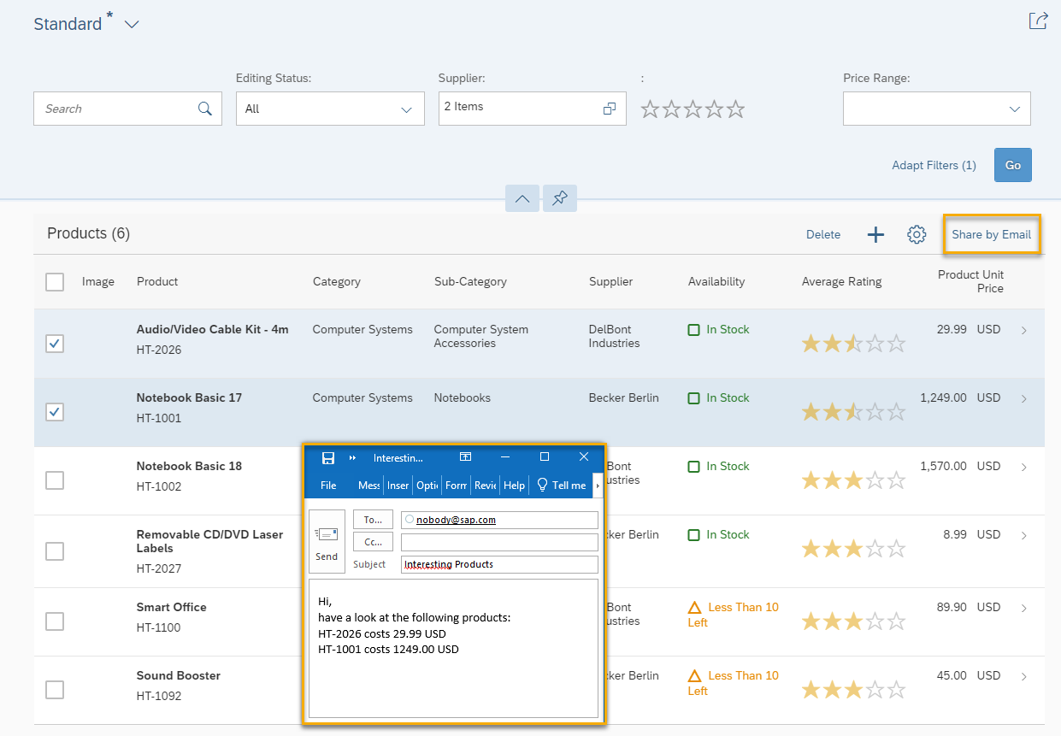
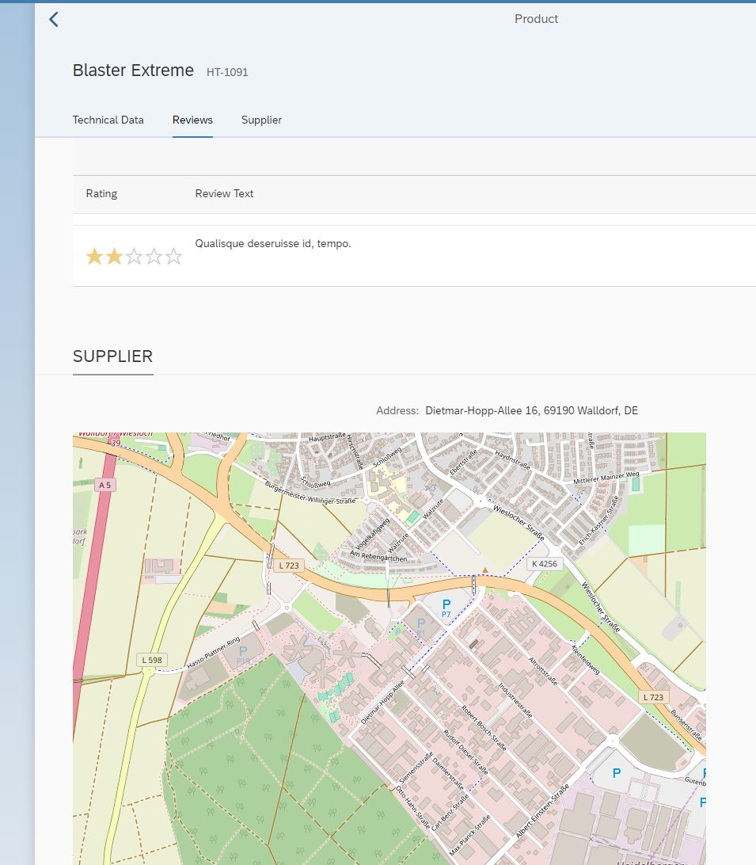
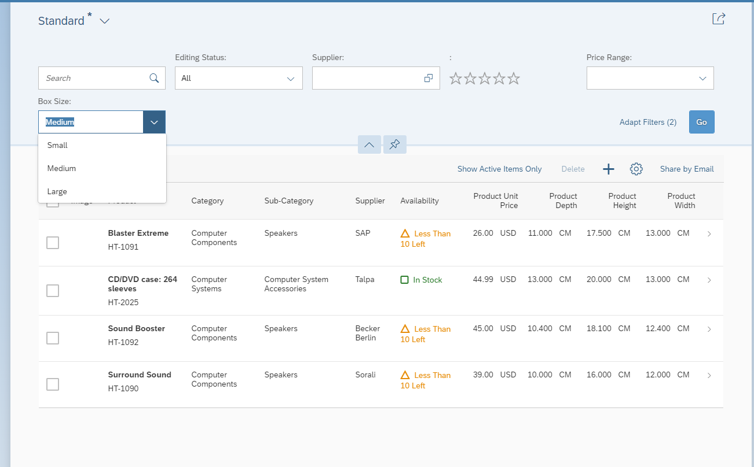
Our Plan
  Extend an existing SAPUI5 application with additional functionality:
  New button, new filter, new section
Prerequisties:
    Get the Hands-On document : https://swennemers.github.io/handson.docx
    SAP Cloud Platform trial account
    SAP Web IDE
    User in SAP Gateway Demo Consumption System ES5

Slide 3
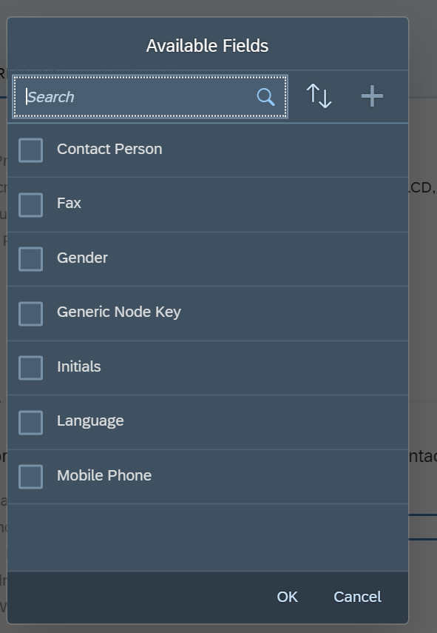
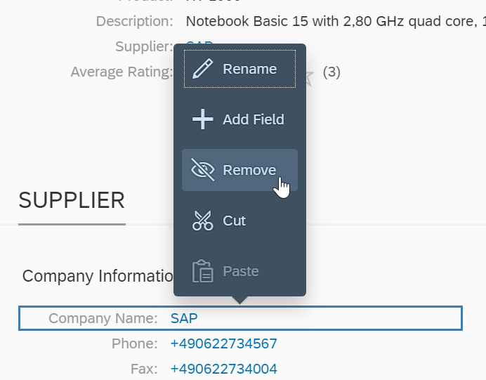
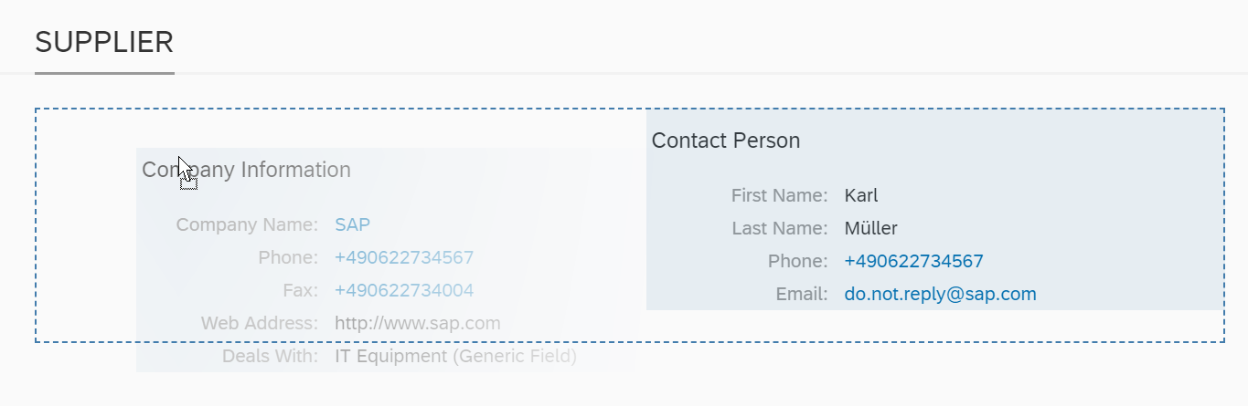
Flexibility - Flexibility is Key
  SAPUI5 flexibility enable functions for different user groups to personalize SAP Fiori apps, adapt their user interface at runtime, and develop new apps.
Benefits:
    Simplified, cost-effective, and easy to use UI change process
    Increased end user acceptance through optimized UI layouts
    Adapted UI changes safe for future system updates
    Easy and intuitive way to adapt the UI

Slide 4
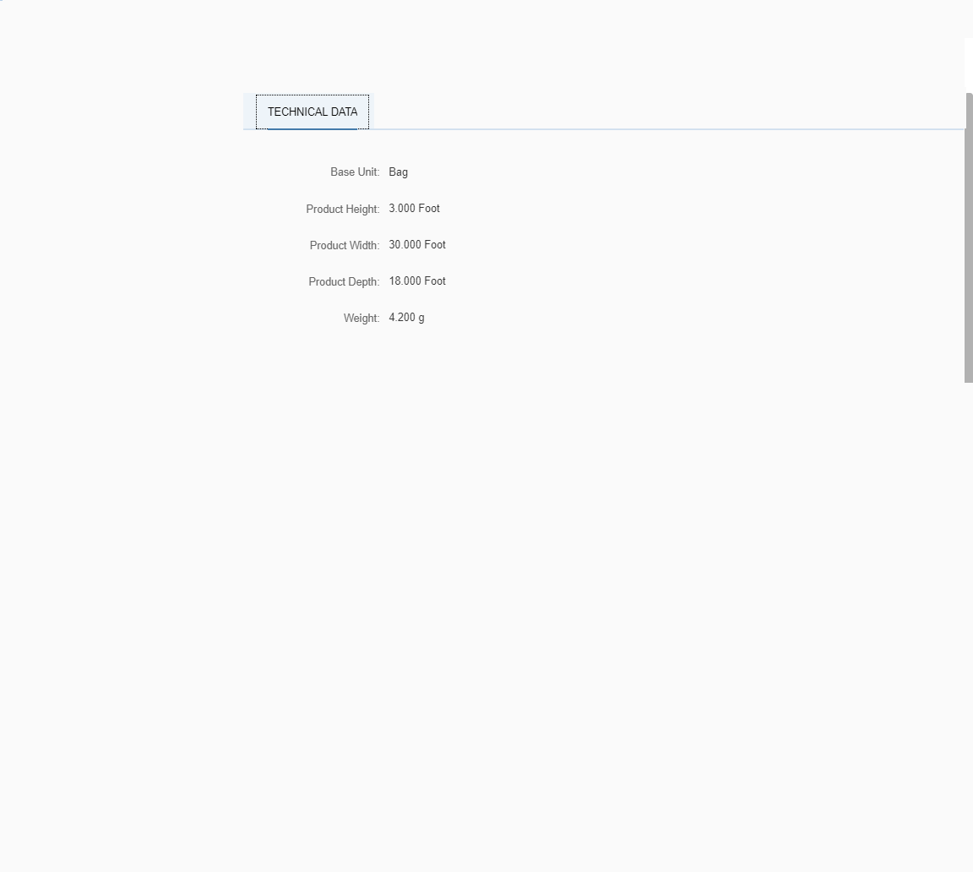
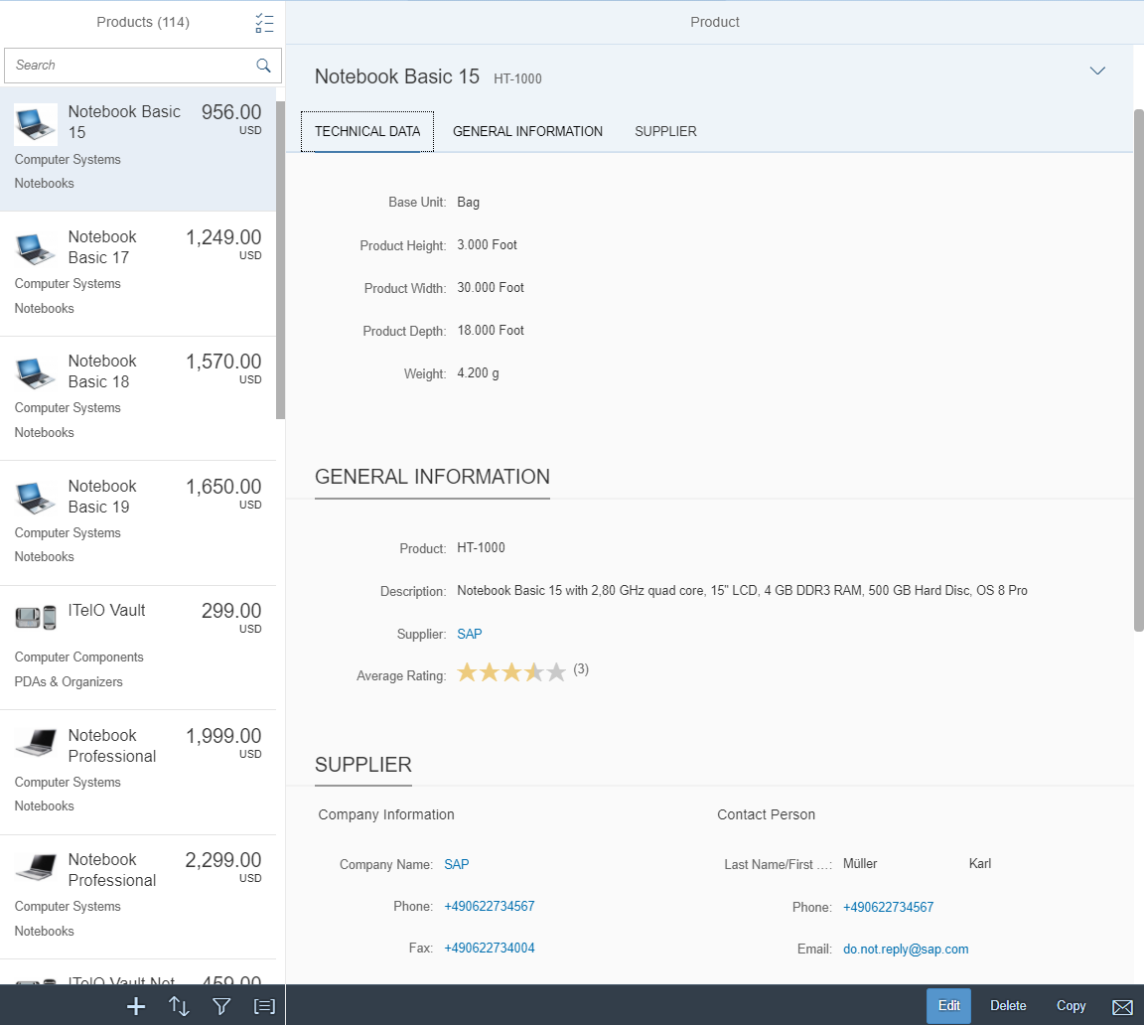
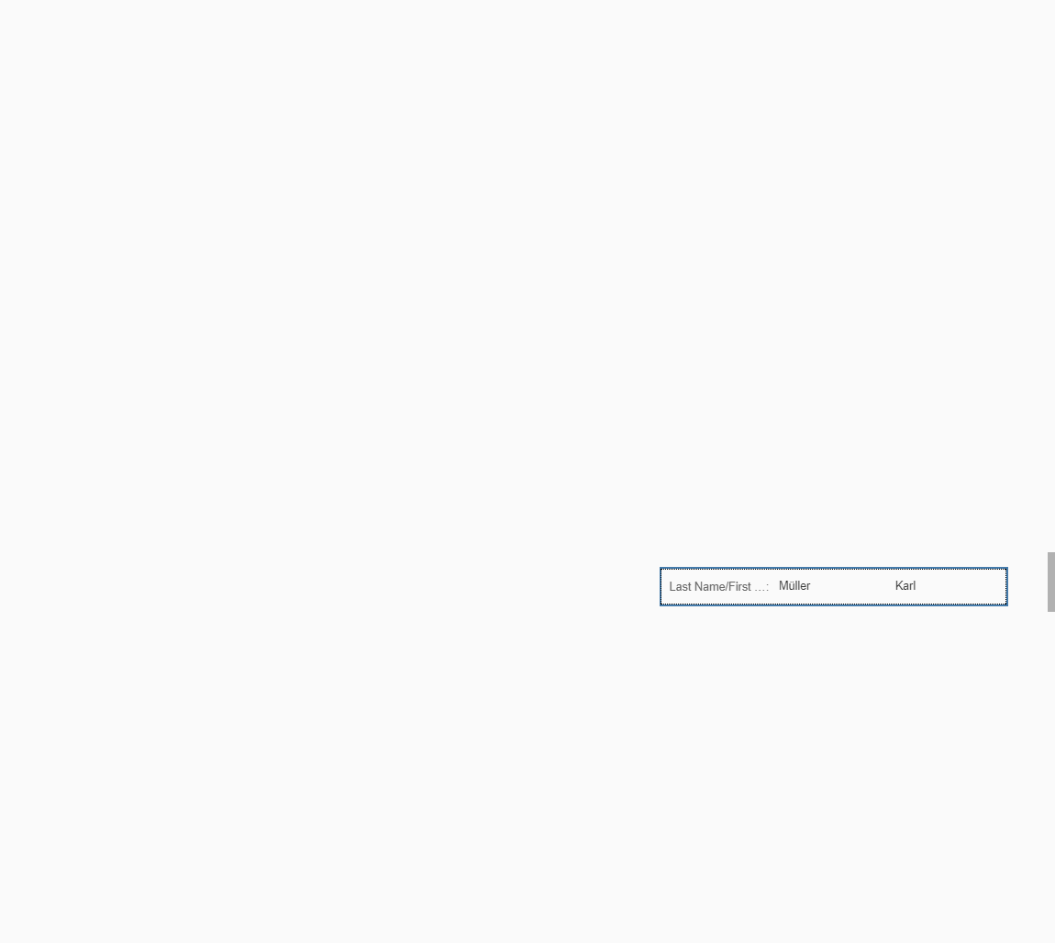

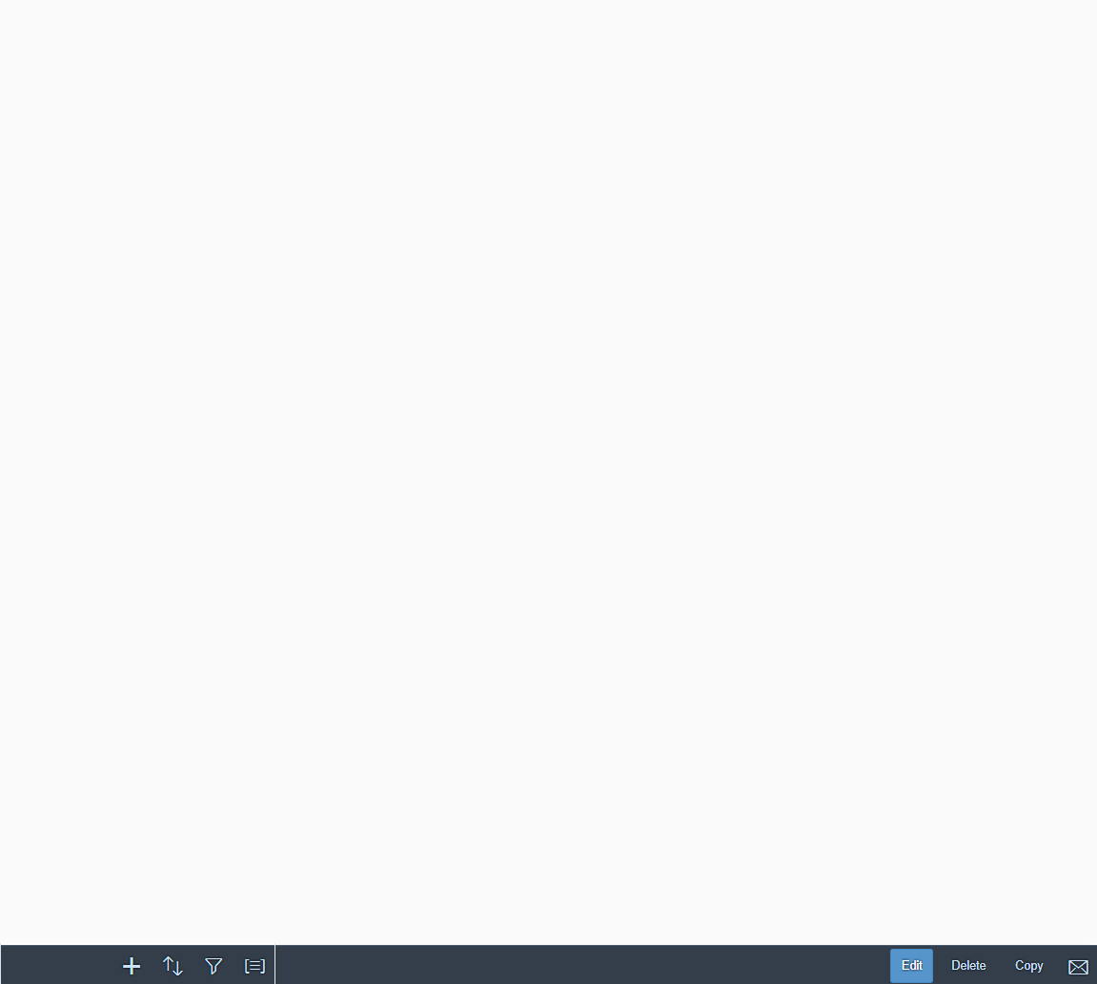

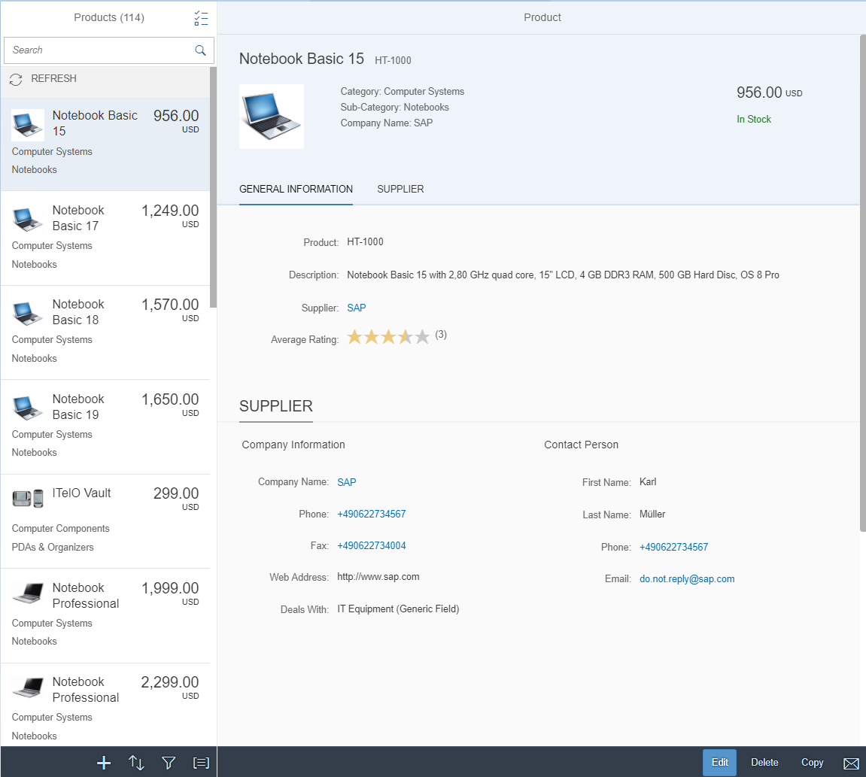


Flexibility – Layering Approach
Flexibility
Personalization
Customer Layer
Key User adaptation
Developer adaptation
SAP Layer

Slide 5
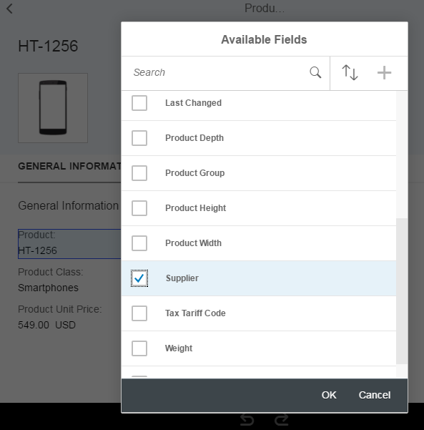
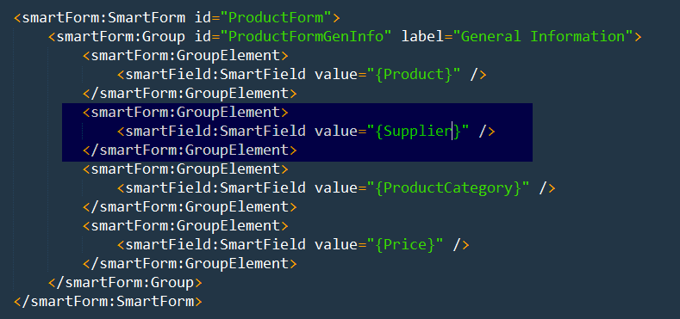
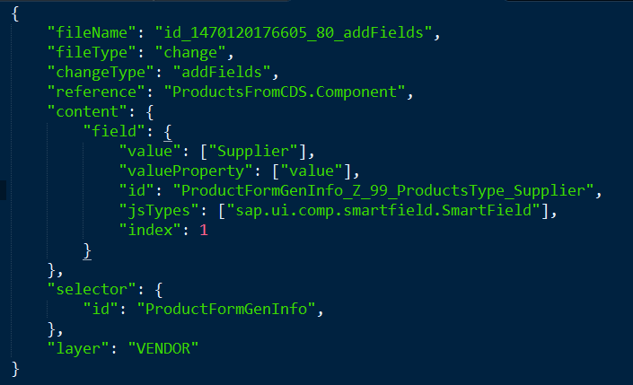
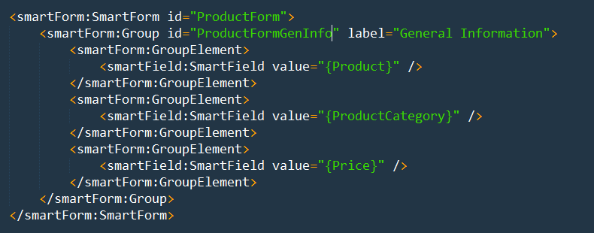
Flexibility – Modification-free Changes
View with a form
A new field is added into the view using UI adaptation at runtime/design-time* …
The change is applied to the view
… and creates a SAPUI5 flexibility change

Slide 6
Flexibility - Personas
* recent innovations
  Developer
  Business Expert,
  Key User
  End User
I want to
  Add/change complex business logic*
  Add new business objects / apps*
  De-couple software lifecycle of standard and extensions*
I want to
    Add custom fields
    Change field descriptions
    Change order of fields
    Create new app variants
    Add/manage control variants (views)
I want to
    Personalize tables and filters
    Save and manage own variants
  My changes should not affect other people
  My changes should affect
  people in my company
  My changes should affect people in my LOB
Notes:
Explain the different personas
--------
We start the hands-on part now! I will slowly do the stuff and explain what I am doing, and you can follow my steps immediately, if there are questions or issues please raise your hand.
Now assume, we are a developer at an air cargo company. Our company is using an SAP delivered app: Show app: https://sapes5.sapdevcenter.com/sap/bc/ui5_ui5/ui2/ushell/shells/abap/FioriLaunchpad.html?sap-client=002&sap-language=EN#Shell-home

Slide 7
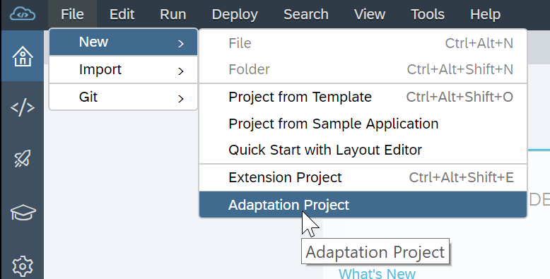
Adaptation Projects in SAP Web IDE
  Adaptation project
    allows developers to adapt existing SAP Fiori Elements based applications
Key Features
    Semantic changes
    Property changes
    Add XML fragments to extend views
    Assign event handlers
    Extend i18n
Notes:
Last year it was „Lab Preview“ => now as hands-on

Slide 8
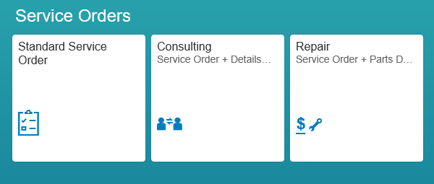


App Variants
original
app variant
Create variant
Original
App variant
Add a tab for parts

Slide 9
Adaptation Projects vs Extension Projects
  Adaptation projects allow a developer to create variants of existing SAP Fiori elements based application. What makes adaptation projects different from extension projects?
Adaptation project
  Supports SAP Fiori elements based applications
  Create semantic app variants with separate app descriptors
  Extend in multiple places
  Expanded set of changes
  i18n extensibility
  Supports multiple layers
Extension project
  Does NOT support SAP Fiori elements based applications
  Extension via manifest configurations
  Extend only in extension points
  Limited options (e.g. no extend for lifecycle methods)
  Only one layer

Slide 10
Flexibility – Platform Support
 | On premise (ABAP) | S/4HANA Cloud | SAP Cloud
 |  |  | Platform (NEO) | Cloud Foundry
personalization Object Pages |  experimental |  experimental |  |  experimental
personalization smart controls & views* |  |  |  | 
pers. and adaptation (sap.ui.fl.variant) |  |  |  | 
Key User Adaptation |  |  | 
App Variants |  | 
SAPUI5 Visual Editor for my own apps |  |  |  |  as part of grunt best practise builds
Adaptation Project & SAPUI5 Visual Editor | 
* views previously known as “control variants”

Slide 11
Additional information

Slide 12
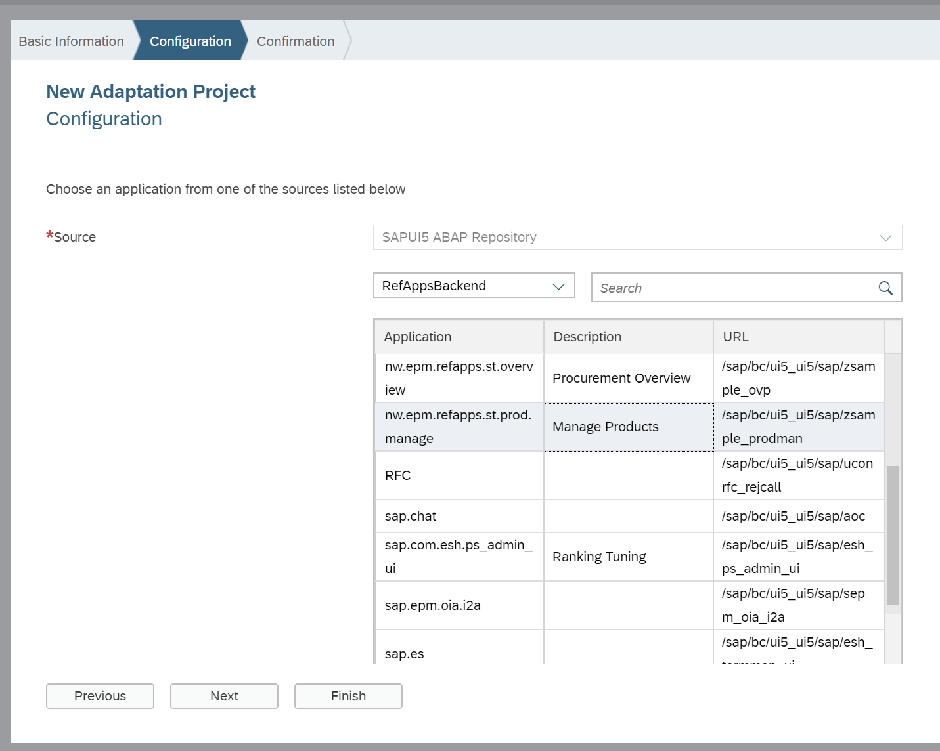
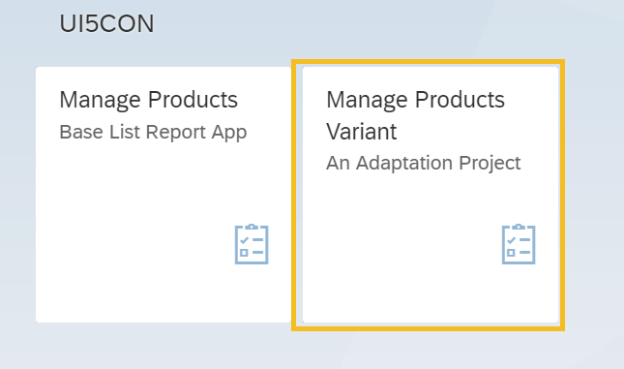
Flexibility – Adaptation Project in SAP Web IDE
New type of project in SAP web IDE
…which allows to create variants of existing apps
…and then configure and deploy them separately.

Slide 13
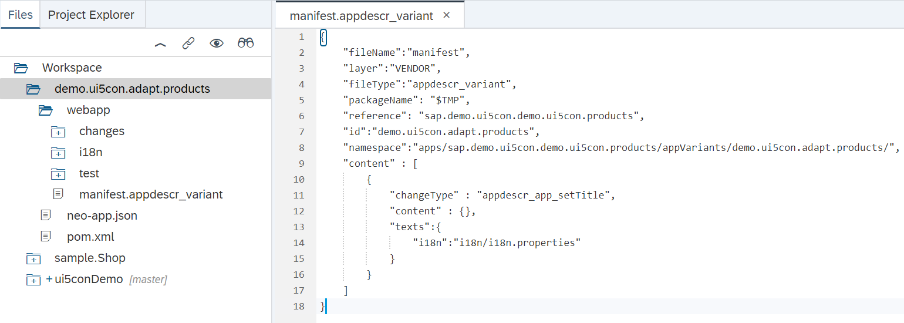
Flexibility – Adaptation Project in SAP Web IDE
Adaptation project reference original application…
…but has an own application id
…and contain separate set of changes.
In this way you can adapt application variant without touching original artefacts!

Slide 14
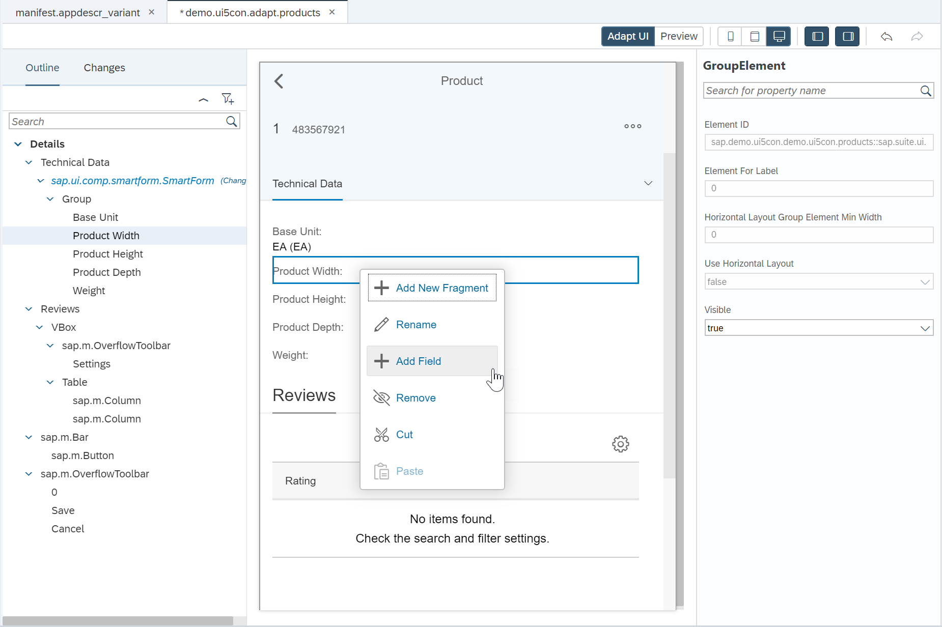
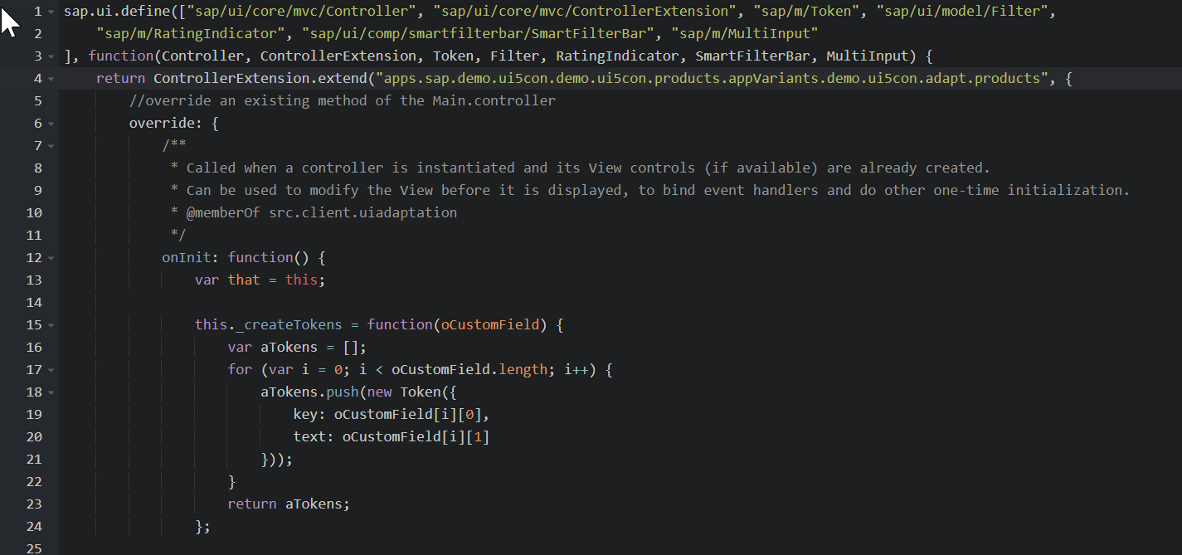
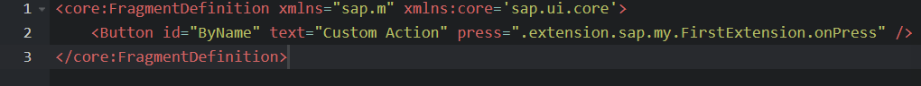
Flexibility – Adaptation Project in SAP Web IDE
Extensibility possibilities of adaptation project include all options available for key users
…but developers are also able to change control properties
…or even extend controller code!
…add XML fragments

Slide 15
Flexibility – Learn More
    SAPUI5 Flexibility
    https://ui5.sap.com/#/topic/a8e55aa2f8bc4127923b20685a6d1621.html
    App Variants for Key Users
    https://blogs.sap.com/2018/06/05/easily-create-app-variants-in-sap-s4hana-cloud/
    Adaptation Project in SAP Web IDE
    Adaptation Projects – it’s time for a new way to extend your Fiori Elements applications
    Extending a SAP Fiori Elements application using Adaptation Projects: Video
    Adaptation Projects: A Tutorial
    Key User Adaptation & Personalization
    https://ui5.sap.com/#/topic/f1430c0337534d469da3a56307ff76af.html
    Key User Adaptation on CP Neo
    https://help.sap.com/viewer/8422cb487c2146999a2a7dab9cc85cf7/Cloud/en-US/f7f671f6c26348d7a662c2c3d120202d.html
    Enabled controls and dev guide
    https://help.sap.com/viewer/4fc8d03390c342da8a60f8ee387bca1a/1805.500/en-US/e144c749695545eba5d5479a40357fa6.html
    openSAP course (Week 5 & 6)
    https://open.sap.com/courses/ui52

Slide 16
Thank you.
Contact information:
  Sebastian Wennemers
  Development Architect
  @S7nW7s

